Slide 1


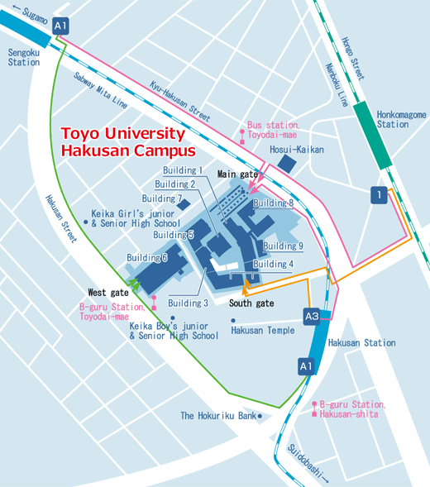
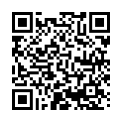
UMAP 25th Anniversary Symposium
◆September 23, 2016 9:30 – 20:00
◆Toyo University Hakusan Campus, Tokyo
125 Commemorative Hall (in Building 8)
Address: 5-28-20 Hakusan, Bunkyo-ku,
Tokyo 112-8606 Japan
Access:
5 minutes from Hakusan Station
8 minutes from Sengoku Station
5 minutes from Hon-Komagome Station
To attend, please register
from the website below
by Sep. 15th.
(Capacity:130)
Japanese and English Interpretation available
125 Commemorative Hall
(Building 8)
QR code:
URL: https://www.toyo.ac.jp/ques/questionnaire.php?openid=660&check

Slide 2

Schedule
*Japanese and English Interpretation available
9:30 | Registration
9:45 | 1．Opening Remarks 1) Chairman : Datuk Dr. Noor Azlan Ghazali (Vice-Chancellor, Universiti Kebangsaan Malaysia) 2) Ministry of Education, Culture, Sports, Science and Technology – Japan 3) Makio Takemura (Secretary General of UMAP IS; President of Toyo University, Japan)
10:00 | 2．Looking Back on 25 Years of UMAP Ichiro Tanioka (Chairman of the Board of Tanioka Gakuen Educational Foundation, Japan) Sumate Yamnoon (Chairman of the Sub-Committee on the 3rd 15-Year Long Range Plan on Higher Education (2017-2031) and the 12th Higher Education Development Plan (2017-2021) Office of the Higher Education Commission, Thailand ) (to be confirmed)
10:30 | 3．Seminar: “Impact of Study Abroad, Issues of international Student Exchanges, and the Analysis of Learning Outcomes” Moderator : Hiroshi Ota (Professor, Hitotsubashi University, Japan) Explanation of the Seminar’s Aims by Shingo Ashizawa (Deputy Secretary General of UMAP IS; Professor, Toyo University, Japan) 1) “Erasmus Impact Study” Uwe Brandenburg (Managing Director, CHE Consult GmbH) 2) “The Importance of Learning Outcomes Assessment in International Exchange” Darla Deardorff (Executive Director, AIEA) 3) Q&A/Discussion
12:10 | ------------------ Lunch Break ------------------
13:30 | 4．Student Presentations by UMAP Participants Moderator: Haruo Miyata (Professor, Niigata University, Japan) Presenters: Students who are studying under UMAP
14:10 | 5．Panel Discussion 1）New Trends of Inter-University Cooperation in Asia (90 minutes) Moderator: Miki Sugimura (Professor, Sophia University, Japan) Panelists: Chantavit Sujatanond (Director, SEAMEO RIHED), Government representatives Bunlay Nith (Deputy Director General of Higher Education, Ministry of Education, Youth and Sport, Cambodia)
15:30 | ------------------ Coffee Break ------------------
15:50 | 2）Future of UMAP and Prospects of Educational Exchange in Asia Pacific Moderator: Taiji Hotta (Professor, Hiroshima University) Panelists: Ki-Jeong Lee (Vice-President, APAIE ) (Speaker to be announced) from Greater Mekong Subregion University Consortium (GMS-UC) Angela Yung-chi Hou (Professor, Fu Jen Catholic University, Taiwan) Alex B. Brillantes, Jr. (Commissioner on Higher Education, Philippines) Representatives of UMAP National Secretariats
17:20 | 6. Closing Remarks Kazuo Takahashi (Vice President for International Affairs, Toyo University, Japan)
17:25 | 7. Group Photograph
18:00 | -----------------Reception (Until 20:00PM)-------------------
*The program above is subject to change without advance notice.
Contact Information:
UMAP International Secretariat
Email:umap-is@umap.org
TEL: +81-3-3945-7190 / FAX: +81-3-3945-7994

